Slide 1
JAVASCRIPT DATA TYPES

Slide 2

JavaScript Data Types
JavaScript provides different data types to hold different types of values
There are two types of data types in JavaScript
Primitive data type
Non-primitive (reference) data type
JavaScript is a dynamic type language, means you don't need to specify type of the variable because it is dynamically used by JavaScript engine.
You need to use var here to specify the data type.
It can hold any type of values such as numbers, strings etc.

Slide 3
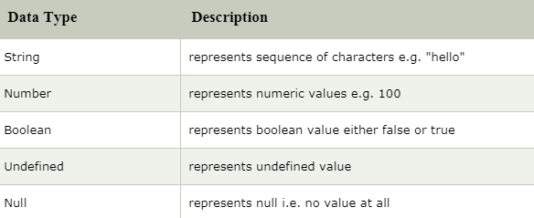
JavaScript primitive data types
There are five types of primitive data types in JavaScript

Slide 4
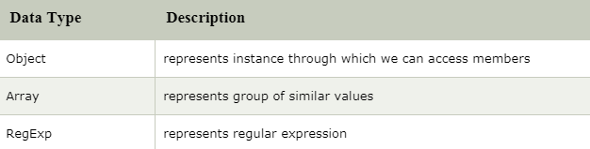
JavaScript non-primitive data types

